Slide 1
True sons of the house must receive from the Spirit of the House
Matt 13:1-17
Receiving the seed of the Kingdom
20/11/16

Slide 2
Why “sons”? (Eph 1)
God initiated the adoption as sons
He wants us to receive the best (v3-5)
He celebrates and lavishes us (v8)
He prepares the futures for us (v9-10)

Slide 3
Why “sons”?
2) Jesus died so that we can be sons
(Gal 4:4-7)
But when the fullness of the time had come, God sent forth His Son, born of a woman, born under the law, to redeem those who were under the law, that we might receive the adoption as sons. And because you are sons, God has sent forth the Spirit of His Son into your hearts, crying out, “Abba, Father!” Therefore you are no longer a slave but a son, and if a son, then an HEIR *of God through Christ.

Slide 4
Why “sons”?
3) The Spirit lead us to be sons
(Rom 8:14-17)
For as many as are led by the Spirit of God, these are sons of God. For you did not receive the spirit of bondage again to fear, but you received the Spirit of adoption by whom we cry out, “Abba, Father.” The Spirit Himself bears witness with our spirit that we are children of God, and if children, then HEIRS*-HEIRS* of God and joint HEIRS* with Christ, if indeed we suffer with Him, that we may also be glorified together.

Slide 5

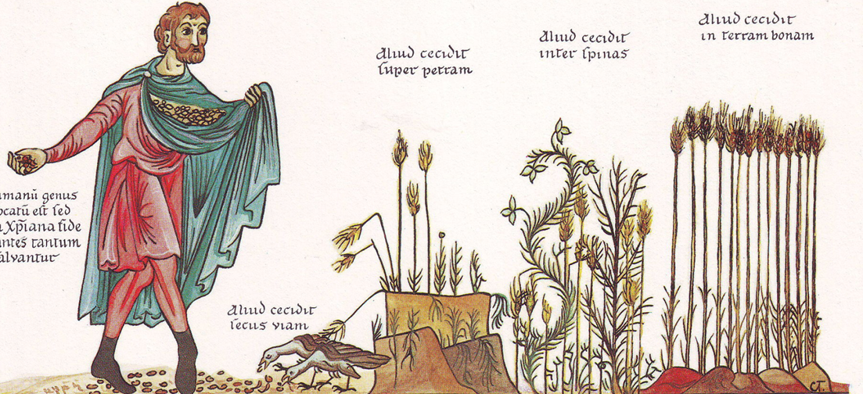
Sons = Heirs. Heirs of the Kingdom
Receive (Listen)
Believe (Convince)
Achieve (Do)
The Word of God is liken unto seeds

Slide 6
Seed vs Bread (Fruit)
Isa 55:6-11 "For as the rain and the snow come down from heaven and do not return there but water the earth, making it bring forth and sprout, giving seed to the sower and bread to the eater, so shall my word be that goes out from my mouth; it shall not return to me empty, but it shall accomplish that which I purpose, and shall succeed in the thing for which I sent it.
Notes:
Which is more valuable

Slide 7
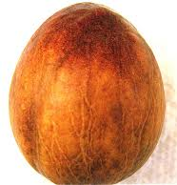
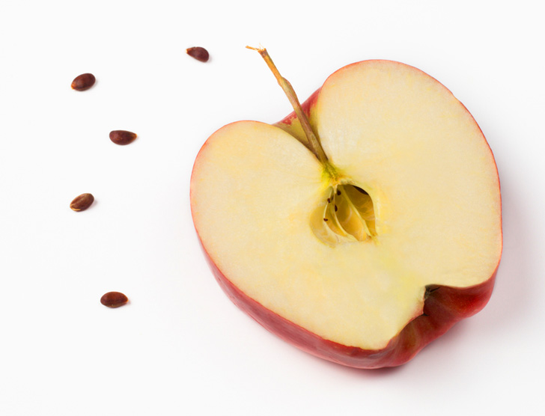
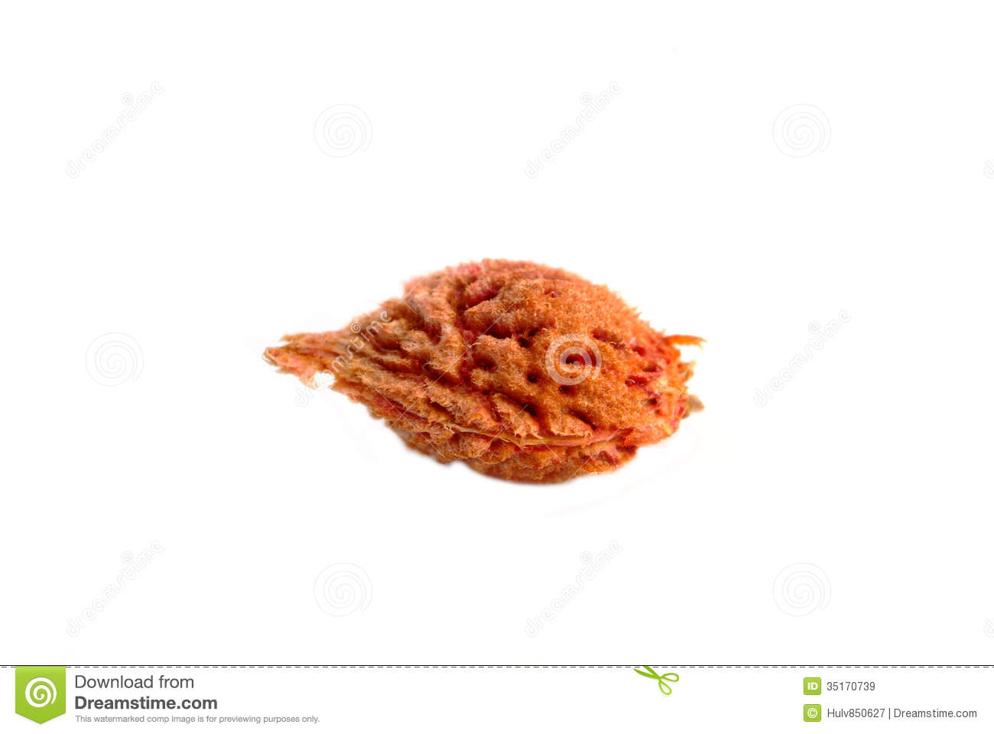
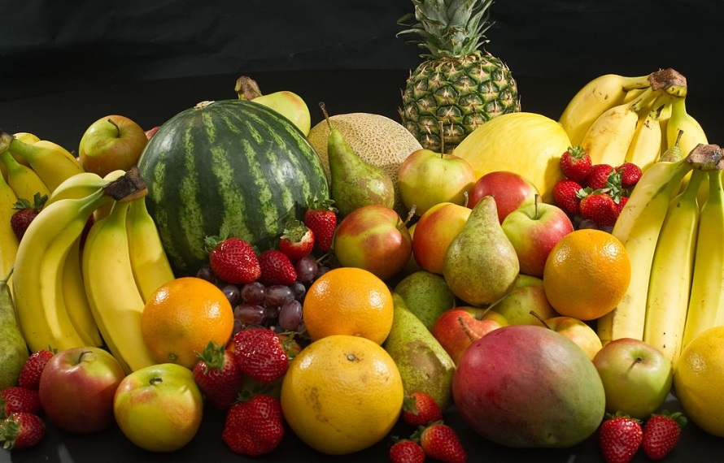
Seed – what’s the difference?
1) Receives NOW, but for the LATER (1 Pet 1:3-9)
- “Benefits invisible now, but visible later

Slide 8
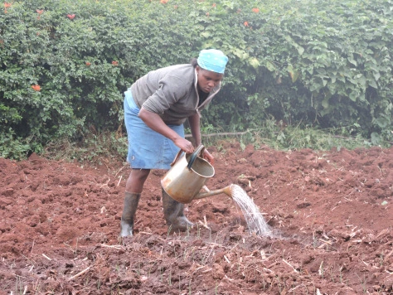
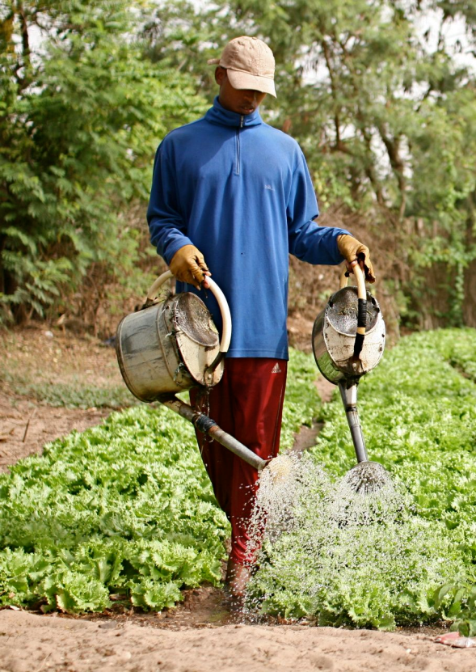
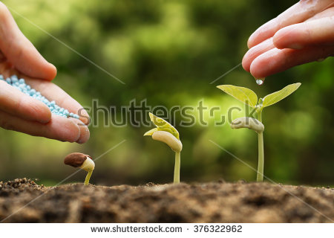
Seed – what’s the difference?
2) Requires “work” - active process (planting, watering, fertilising, guarding)
- Phil 2:12-13, 1 Cor 3:6-9

Slide 9
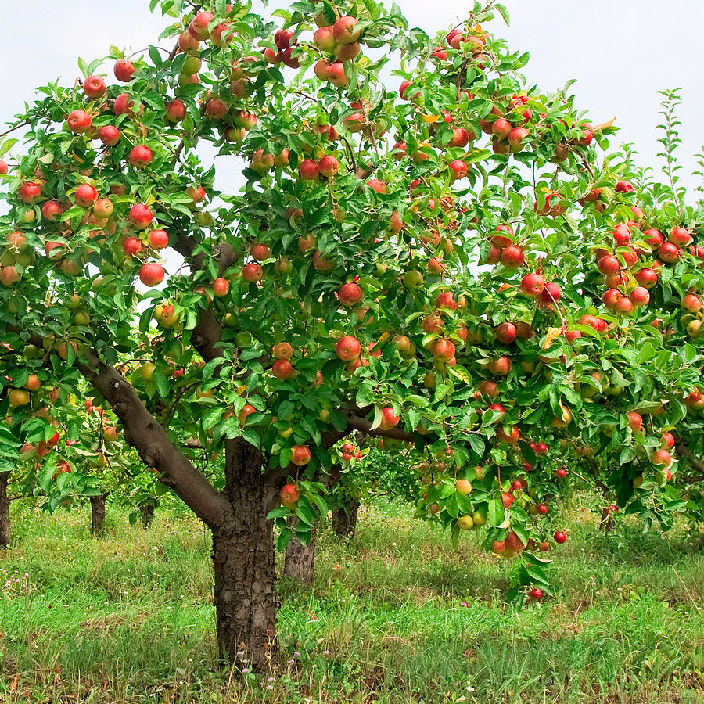
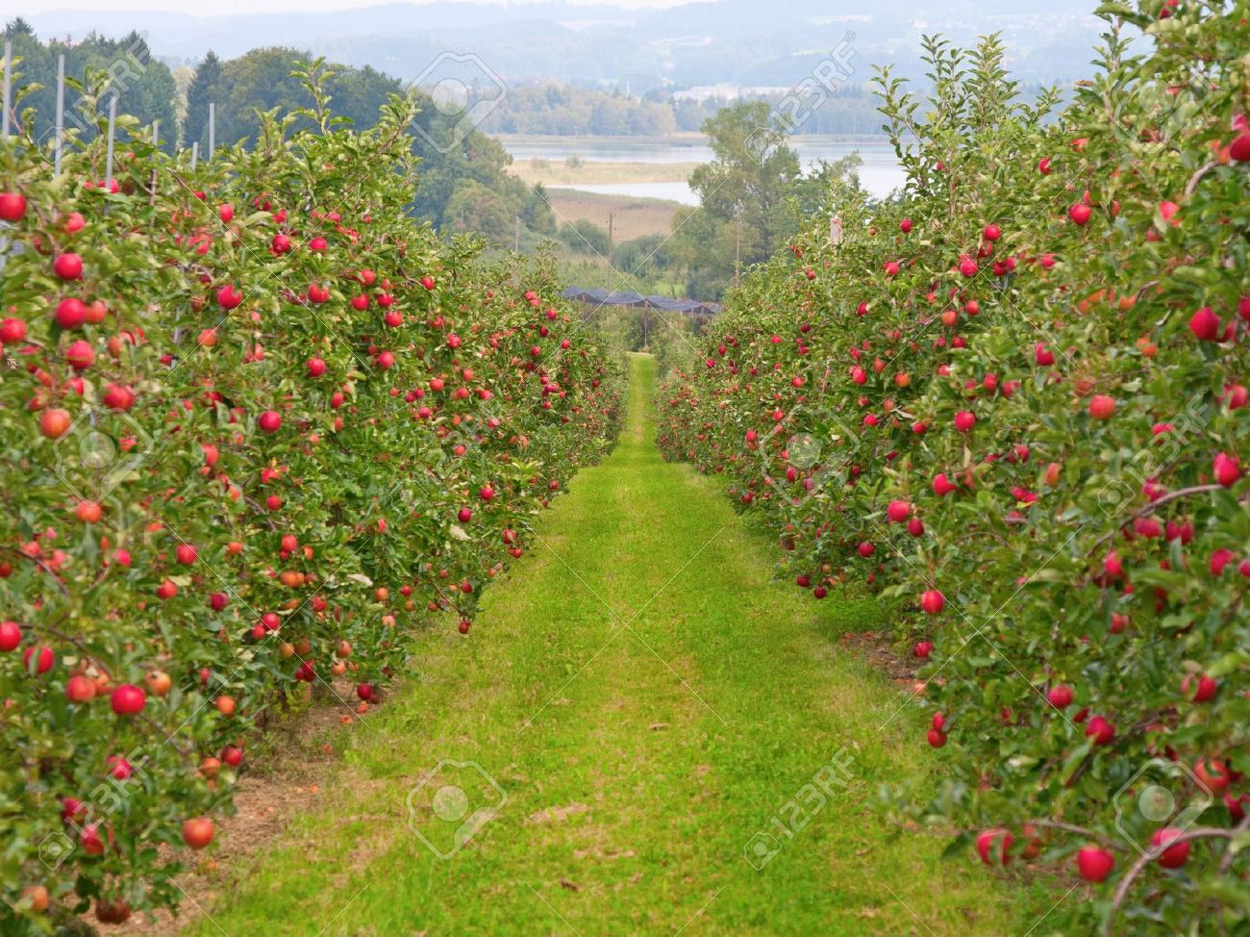
Seed – what’s the difference?
3) Seems small now but have potential to multiply

Slide 10
Conclusion
Matt 6:33 - Seek the Kingdom
= receive the seed (the Word)
The journey to perfection starts with one decision
Guard the seeds and take good care of it, and the increase will come
Once we receive the seed, the Word, we become the seeds (sons)

